Slide 1
TB Real Estate Corporation
By
Michael Ward

Slide 2
The Problem:
Identify residential property investment opportunities in the Tampa Bay area
Notes:
TB Real Estate Corporation is a real estate investment firm in the Tampa Bay, Florida area. The real estate market in the Tampa Bay area is very active. Single family homes are selling quickly. TB Real Estate Corporation needs to be able to assess the value of homes coming onto the market quickly and accurately so that they can beat the competition in making a competitive offer. They need to be able to evaluate the listing price against the predicted sale price in order to identify properties that may be priced below market value and would make good investments.

Slide 3
The Solution:
Beat the competition
to contracting purchases
by reducing time and expense in identifying
the best investment opportunities
Notes:
My proposed solution is to identify the best areas of Hillsborough County to invest in and then use machine learning to quickly identify properties that are listed for sale below the market value in order to beat the competition in making an offer and securing a Purchase & Sale contract.

Slide 4
Data Wrangling
Only consider data from the year 2000
Only consider single family residential homes (3-5 beds / 1-4 baths
Merge data and drop redundant and useless columns
Drop rows with invalid outliers
Impute missing values and extract composite values
Target Variable: Sales Amount
Original datasets had ~2,170,000 property sale records with 17 columns and ~512,000 parcel records with 47 columns
Data Source: https://downloads.hcpafl.org/
Notes:
The HCPA provides new zip files each week on their website which contain the most current sales data, parcel data, supporting files, and explanatory documents. The sales and parcel data files are in database file format (*.dbf). The parcel file included all 512,206 parcels in Hillsborough County with 47 features to describe each parcel. The sales file contained 2,166,282 property sale records dating back to 1980. Each sale is made up of 17 features.
There were 0.066% of sales records that did not have a matching Folio ID in the parcel data.
Focus on single family homes that with 3-5 bedrooms, 1-4 bathrooms, and less than 20 years old.
Impute data such as Actual Year Built with Original Sales Date.
Extract location information from PIN (Municipality Code, Section, Township, Range, Subdivision, Block, and Lot)
Extract Market Area from Neighborhood Code and map Region of county

Slide 5
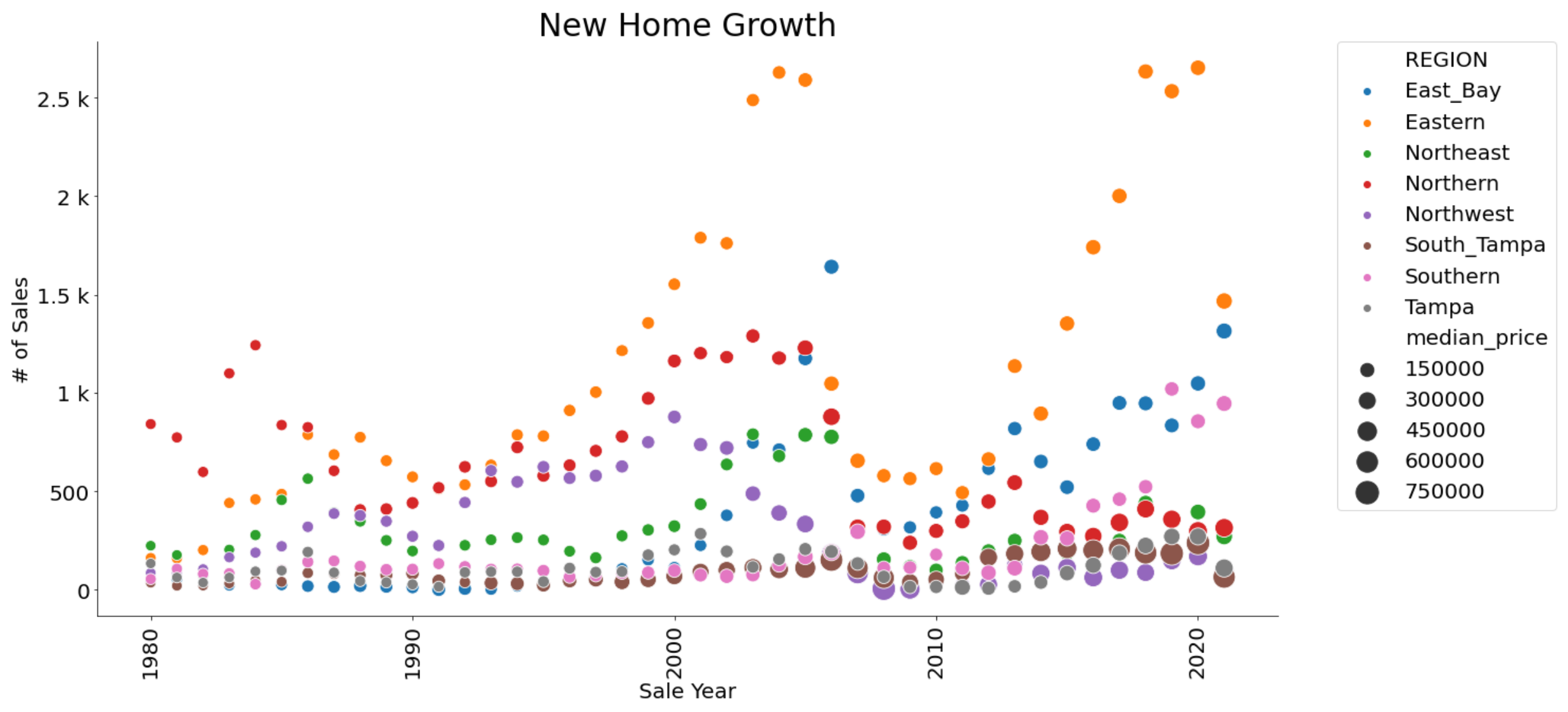
Exploratory Data Analysis
Eastern, East Bay, and Southern regions have the greatest growth
Notes:
Just prior to the 2006 market crash and following the recovery post-2011, the greatest growth in new home construction was in the Eastern, East Bay, and Southern regions of the county. The South Tampa region has seen the greatest growth in terms of sales prices.

Slide 6
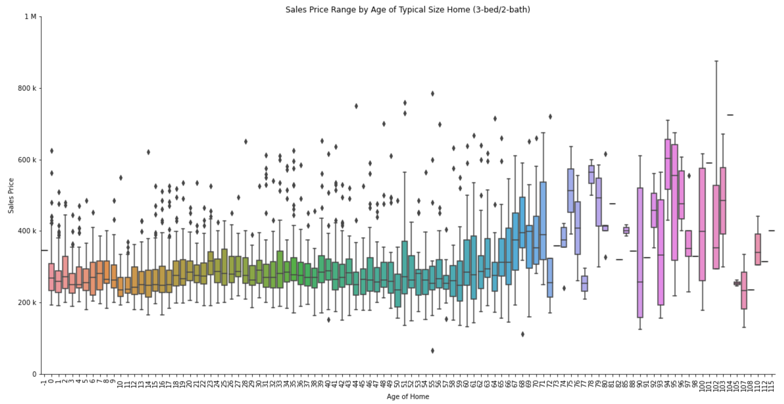
Older Homes Less Predictable
Sales prices increasingly vary for older homes based on the condition of the home
Notes:
As the age of the home goes beyond 20 years, the condition of the homes and sales prices increasingly vary. In order to mitigate the risk of purchasing investments that require significant costs of repair and maintenance, TB Real Estate will restrict their investments to home that are less than 20 years old.

Slide 7
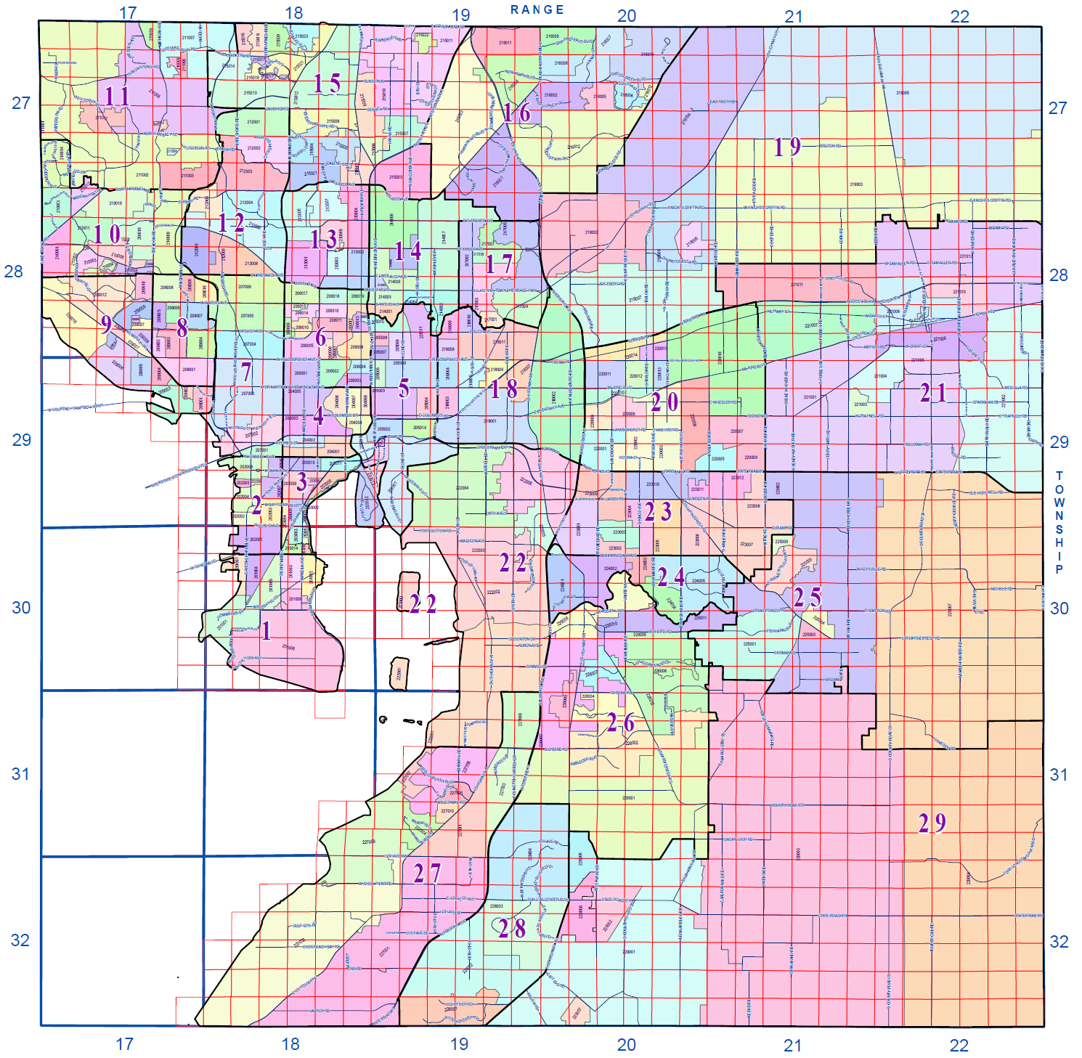
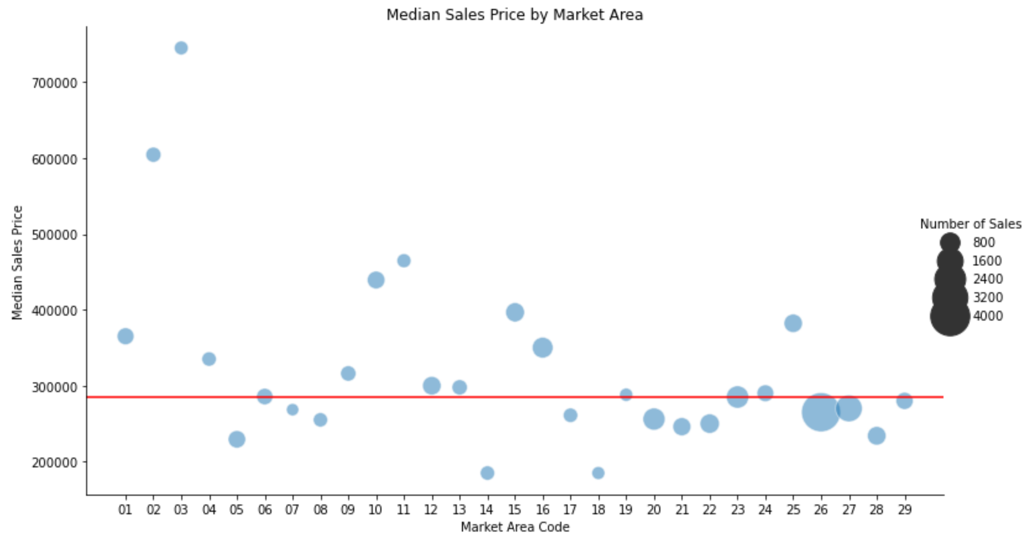
Hottest Market - Riverview (#26)
Most home sales over the past year
Median sales prices < county median
Highest growth area for new homes
Notes:
Market Areas 26 and 27 (Riverview and Southbay) had the most property sales over the year and the median sales prices that are slightly below the median for the county.
These Southeastern Market Areas are attractive for investments due to the following features:
Most home sales over the past year
Lowest median age of homes sold
Median sales prices below the county median sales price
Of the top-10 Neighborhoods for number of sales, 7 of them are in Market Areas 26 and 27.

Slide 8
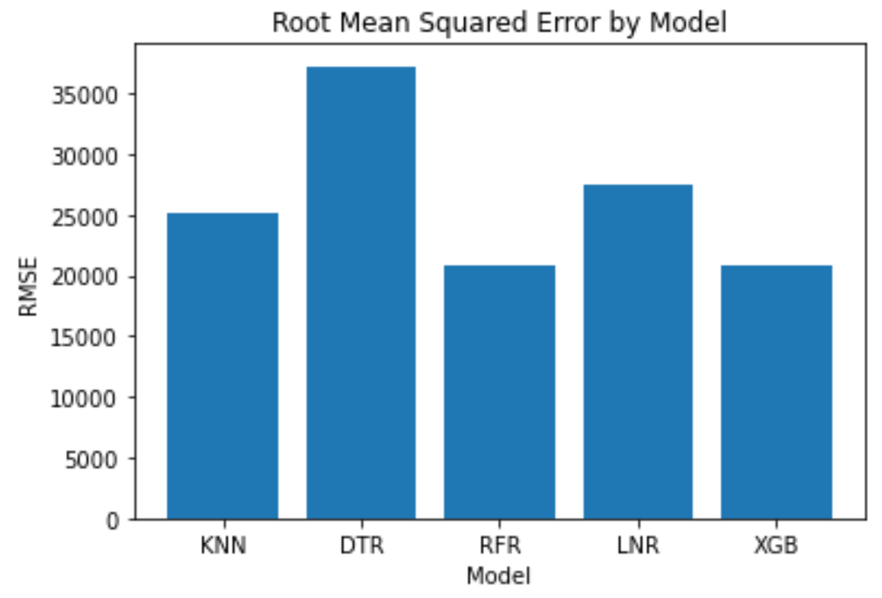
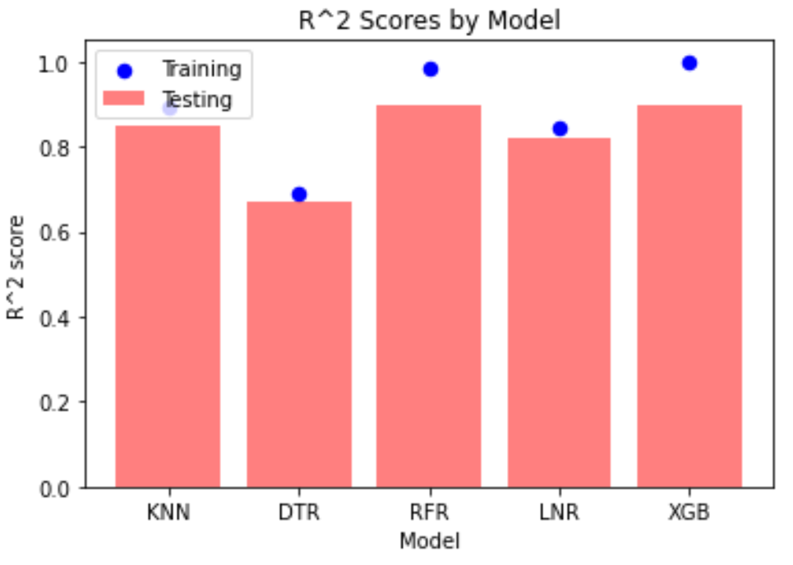
Model Selection
Target Metric:
Root Mean Squared Error
Ranking
Extreme Gradient Boosting Regressor (XGB)
Random Forest Regressor (RFR)
K Nearest Neighbors Regressor (KNR)
Linear Regression (LNR)
Decision Tree Regressor (DTR)
Notes:
I executed over 20 iterations where I adjusted and engineered features, encoding methods, and selections of data in order to tune the models. For each iteration, I captured the results in a dataframe in order to easily compare the metrics of the different models.
While performing error analysis, I found that there was erroneous data in the sales data file that was downloaded from the HCPA website on 2/11/2022. I cross-referenced the poorest predictions to the HCPA website and found that the sales had since been updated from “Qualified” sales to “Unqualified” sales which means that they were not verified, free-market sales. Apparently, at least some sales are initially captured as “Qualified” and later changed to “Unqualified” presumably after some review has been done. This drove me to analyze the 2020 data rather than the 2021 data in order to mitigate the risk of introducing invalid, “Unqualified” sales into the model.
The Random Forest Regressor and Extreme Gradient Boosting had similar results and were significantly better than the other three models.

Slide 9
Hyperparameter Tuning
Extreme Gradient Boosting Regressor
Best Parameters:
n_estimators: 500
max_depth: 15
learning_rate: 0.05
min_child_weight: 3
Randomized Search
5 –Fold Cross Validation
Notes:
In order to optimize the hyper parameters, I used a Randomized Search with 5-fold Cross-Validation. Randomized Search was chosen over Grid Search in order to reduce processing due to the size of the data. The following hyperparameters were tested for each model.
K Nearest Neighbors (KNeighborsRegressor)
n_neighbors: 1 – 50
weights: “uniform”, “distance”
Decision Tree (DecisionTreeRegressor)
Splitter: "best","random"
max_depth: 1,3,5,7,9,11,12
min_samples_leaf: 1,2,3,4,5,6,7,8,9,10
min_weight_fraction_leaf: 0.1,0.2,0.3,0.4,0.5,0.6,0.7,0.8,0.9
max_features: "auto","log2","sqrt",None
max_leaf_nodes: None,10,20,30,40,50,60,70,80,90
Random Forest (RandomForestRegressor)
bootstrap: True, False
max_depth: 10, 20, 30, 40, 50, 60, 70, 80, 90, 100, 110, 120
max_features: 'auto', 'sqrt'
min_samples_leaf: 1, 3, 4
min_samples_split: 2, 6, 10
n_estimators: 5,20,50,100
Linear Regression (LinearRegression)
fit_intercept: True, False
Extreme Gradient Boosting (XGBRegressor)
n_estimators: 100, 500, 900, 1100, 1500
max_depth: 2, 3, 5, 10, 15
learning_rate: 0.05, 0.1, 0.15, 0.20
min_child_weight: 1, 2, 3, 4

Slide 10
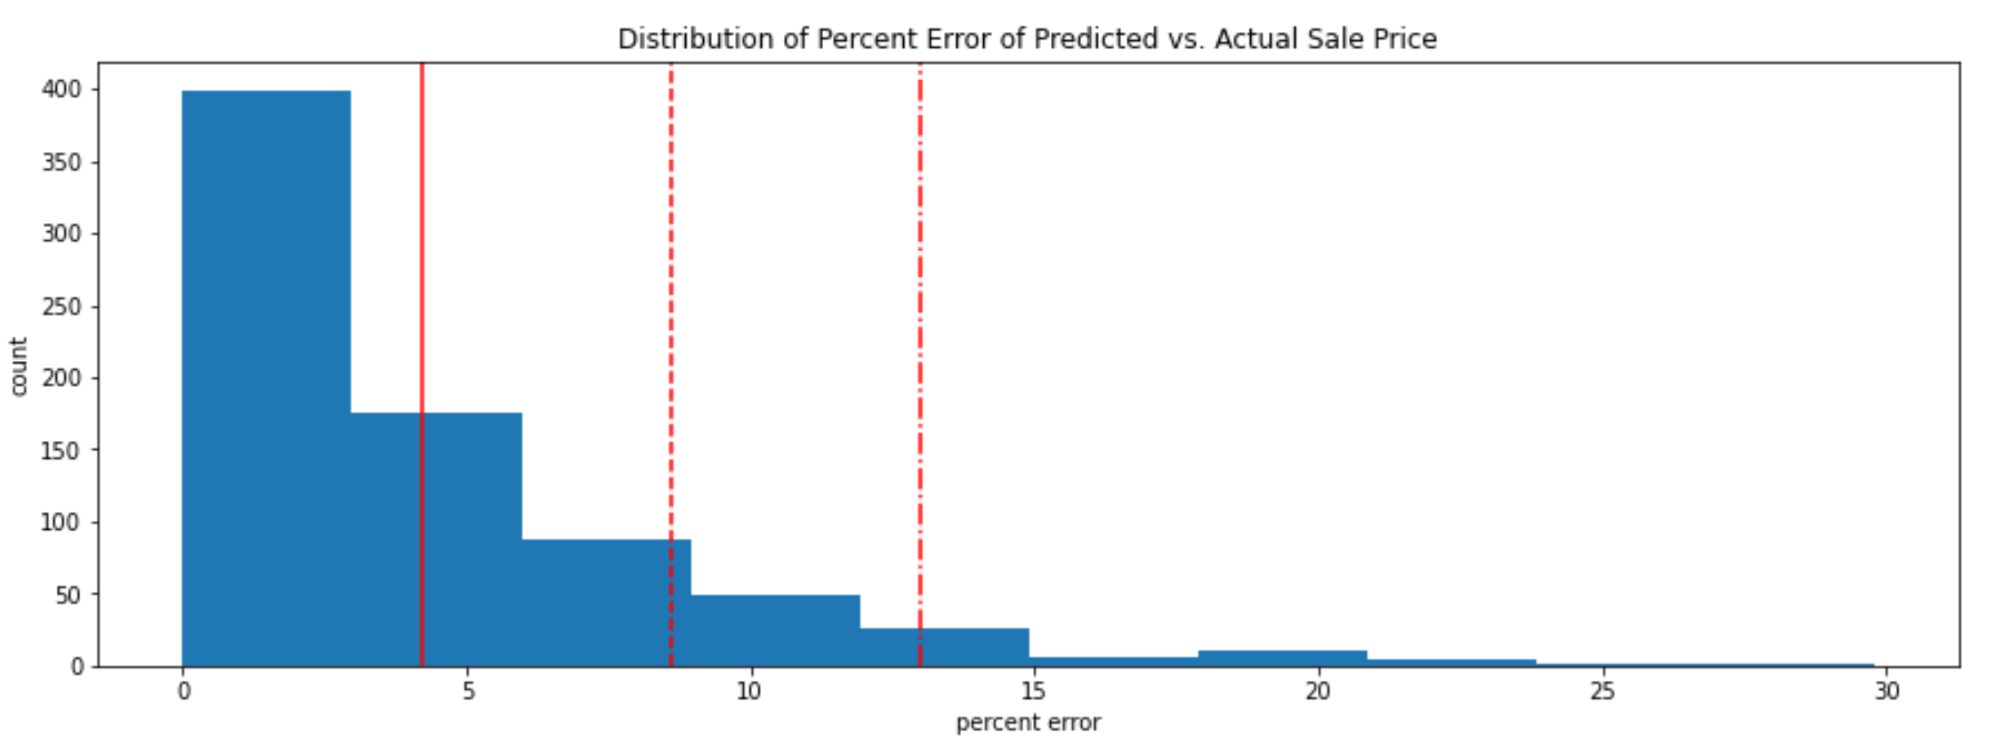
Best Model: Extreme Gradient Boosting
Most predictions were within 5% of the actual sales price
Notes:
I decided to select the Extreme Gradient Boosting (XGB) model with the following hyperparameters as this resulted in the lowest Root Mean Squared Error of 20,818.
n_estimators: 500
max_depth: 15
learning_rate: 0.05
min_child_weight: 3
In comparing the predicted sales prices to the actual sales prices, the percentage of error for most of the test cases was less than 5%.

Slide 11
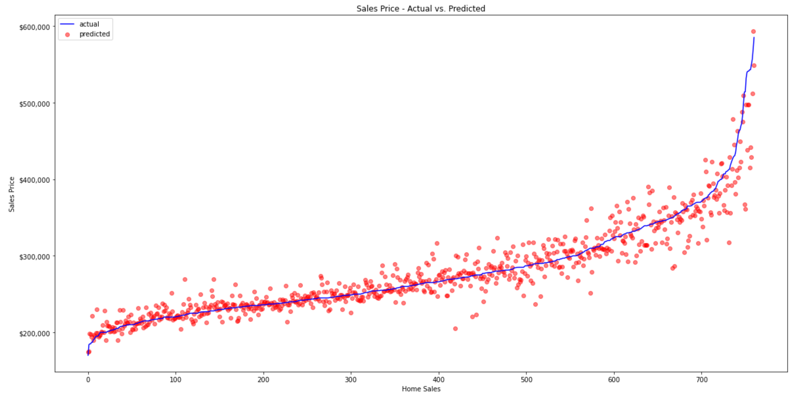
Best Model: Extreme Gradient Boosting
Error variance amount increases with sales price
Notes:
While error percentage was relatively consistent, error variance amount increases with price

Slide 12
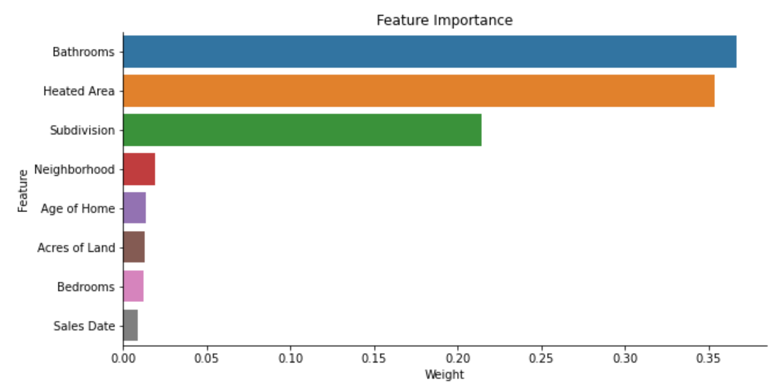
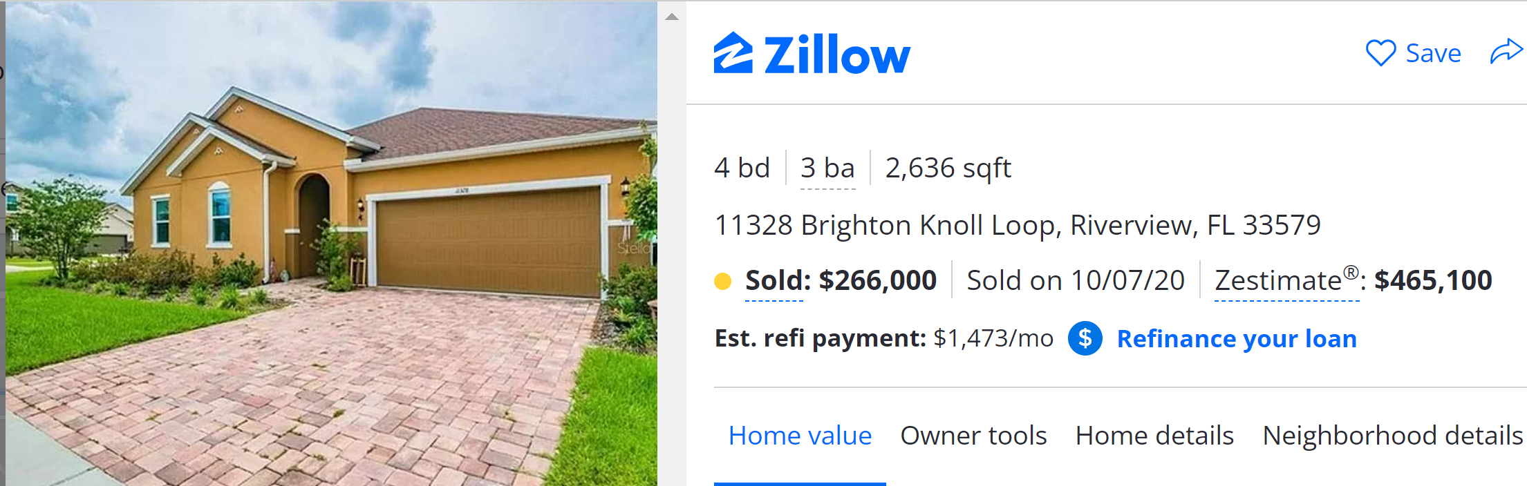
Top Features in Predicting Sales Price
Riverview Market Area
Single Family Homes
3 – 5 Bedrooms
1 – 4 Bathrooms
< 20 Years Old
Predicted Price: $316K
Sold Oct 2020: $266K
Current Value *: $465K
Total $ Gain: $199K
Total % Gain: 75%
* According to Zillow, the current Zestimate® is $465,100
https://www.zillow.com/homes/11328-Brighton-Knoll-Loop-Riverview,-FL-33579_rb/125990862_zpid/
Notes:
Based on the Exploratory Data Analysis, I determined that the following features would be good candidates for modeling.
Types of Sales
Single Family Residential Homes (DOR Code 0100)
Qualified (verified as free-market sales)
Improved (post-construction sales – not vacant land)
Sales from the 2020 calendar year
Home Features
Bedrooms (3 to 5)
Bathrooms (1 to 4)
Buildings / Units (1 only)
Stories (1 to 2 only)
Age of Home (less than 20 years old)
Heated Area
Acres of Land
Property Locations
Market Area (26 – Riverview)
Neighborhood Code (Target Encoding)
Subdivision Code (Target Encoding)
Taxable Values of Properties
None (invalid predictors)

Slide 13
Takeaways
XGBoost Regressor was best model
Number of Bathrooms, Heated Area of Home, and Subdivision matter most
A lot of features are not important (Reduced columns from 64 to 8)
Different ages of homes have different predictability

Slide 14
Future Research
Additional years of sales
Expand to entire county
Acquire data on condition of home
Acquire data on additional features of home
Acquire data on waterfront property
Notes:
The modeling was done with 1 years’ worth of sales data. Additional years of data could be tested in order to determine if it would improve the model.
The modeling was done for the Riverview Market Area. This could be improved by including all of Hillsborough County.
In order to evaluate homes greater than 20 years old, it would be beneficial to understand the condition of the property and the home. Potentially, additional datasets could be gathered to provide data on improvements such as roof replacements, electrical updates, etc.
It would be helpful to understand any improvements made to the properties such as pools, sheds, docks, etc. This may be able to be acquired through building permits as well.
In Hillsborough County, there is a lot of waterfront properties including the Gulf of Mexico, lakes, ponds, and rivers. This has a big impact on market value and potentially could be accessed with ArcGIS mapping datasets.

Slide 15
Questions?

